Slide 1
MANUAL TESTING ON SNAPDEAL

Slide 2
INDEX
Manual Testing
STLC and Stages of STLC
E-Commerce Testing
Types of testing can be performed
Performance testing
Flowchart
Useful tools
Test case design techniques
Use case
Test case
Requirement traceability matrix
Bug report
Bug report contents

Slide 3
MANUAL TESTING
Manual testing is the one in which application testing happens manually. The test cases/scenarios are executed one by one by Testers (professional involved in software testing) manually without using any readymade tools, and then the results are verified.
So manual testing is a process in which we compare the behavior of a piece of software (it can be a component, module, feature, etc.) with the predefined, expected behavior which we set during the initial phases of SDLC.

Slide 4
STLC AND STAGES OF STLC
The Software Testing Life Cycle (STLC) is a sequence of specific actions performed during the testing process to ensure that the software quality objectives are met. The STLC includes both verification and validation
Requirements analysis;
Planning;
Engineering and design;
Software development;
Testing;
Deployment.

Slide 5
E-Commerce Testing
eCommerce testing is defined as testing of an eCommerce (online shopping) application. It helps in the prevention of errors and adds value to the product by ensuring conformity to client requirements.
Setting up an E-commerce system is a complex process and subject to many market-specific variables. To maintain the integrity of the E Commerce system, testing becomes compulsory

Slide 6
Types of testing can be performed
Login and Security | Login capability Penetration and access control Insecure information transmission Web attacks Computer viruses Digital signatures
Performance | Performance bottlenecks Load handling Scalability analysis
Shopping order processing and purchasing | Shopping cart functionality Order processing Payment processing Order tracking

Slide 7
Browser compatibility | Lack of support for early browsers Browser specific extensions Browser testing should cover the main platforms (Linux, Windows, Mac etc.)
Transactions | Transaction Integrity Throughput Auditing
Page display | Incorrect display of pages Runtime error messages Poor page download time Dead hyperlink, plugin dependency, font sizing, etc.

Slide 8
Performance testing -a top priority in Ecommerce
Just delay about 250 milliseconds of a page load time, is what keeps your customer going to your competitor.
Performance of your site depends on these factors
Throughput
Request per second
Transactions per minute
Executions per click
Response Time
Duration of a task
Seconds per click
Page Load
Length of time between click and seeing page

Slide 9
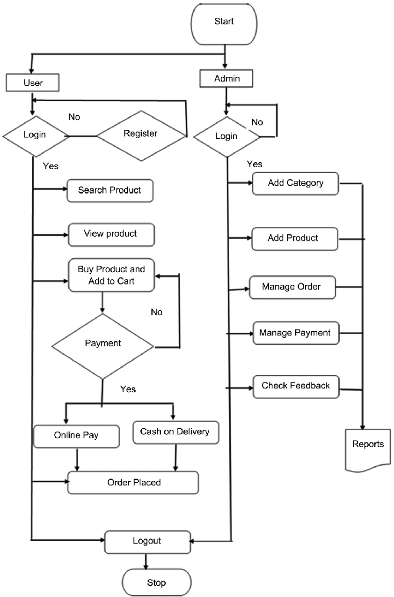
FLOWCHART

Slide 10
Useful Tools for Mapping E-commerce Site
UsabilityHub
Feng-GUI
Optimizely
FiveSecondTest
HotJar

Slide 11
Test Case Design Techniques
Boundary Value Analysis
Equivalence class partitioning
Decision Table
State transition diagram
Use case diagram

Slide 12
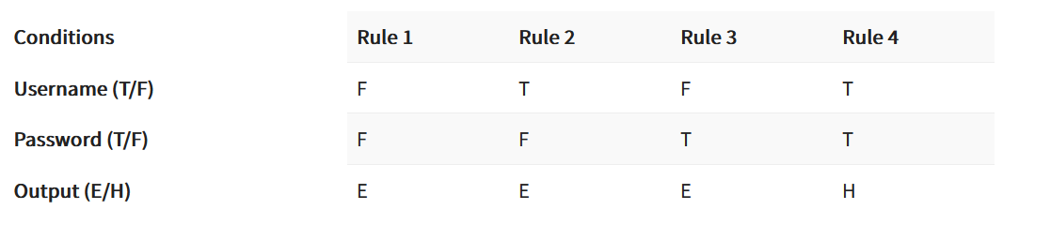
Decision Table
Legend:
T – Correct username/password
F – Wrong username/password
E – Error message is displayed
H – Home screen is displayed

Slide 13
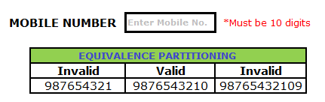
Equivalence class Partitioning for mobile number validation

Slide 14
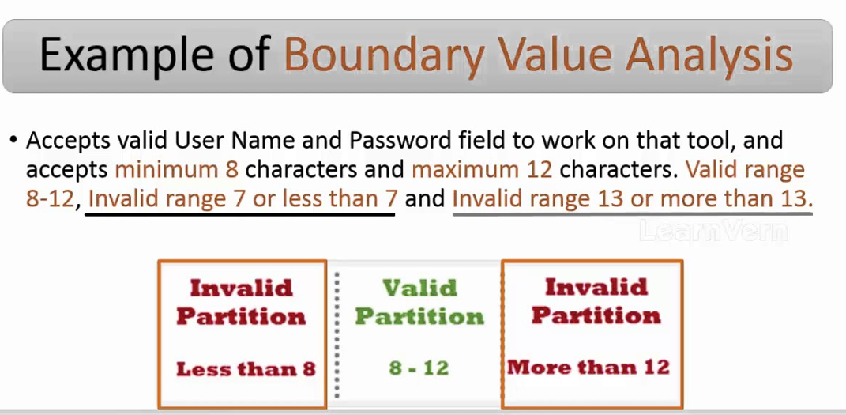
Boundary value Analysis for username and password

Slide 15
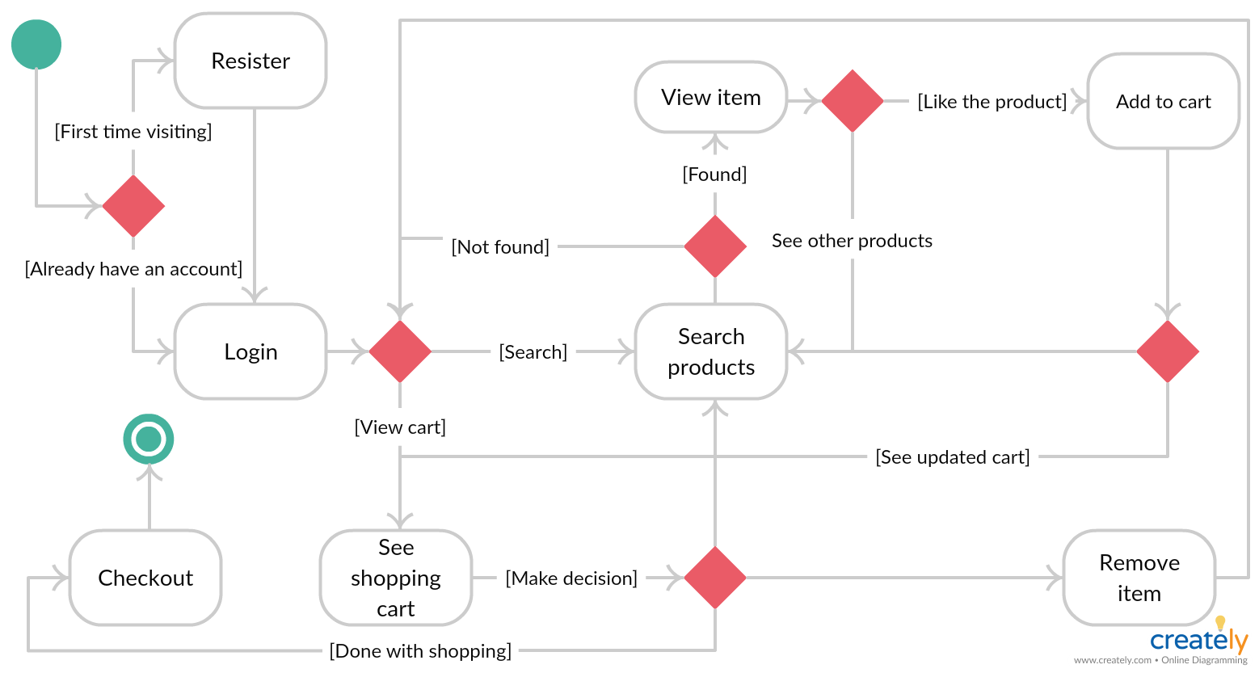
State transition diagram

Slide 16
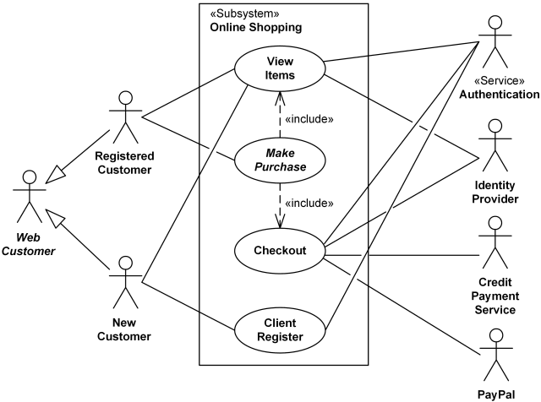
Use case diagram

Slide 17
Use case
Visit a site
Login
Search for Items
Check Availability of Items
Add Items to Shopping Cart
Edit Items in the Shopping Cart
remove Items from the Shopping Cart
Check out the Shopping Cart
Check Order Status
Browse Order History
Display Item Details
Logout
Leave a site

Slide 18
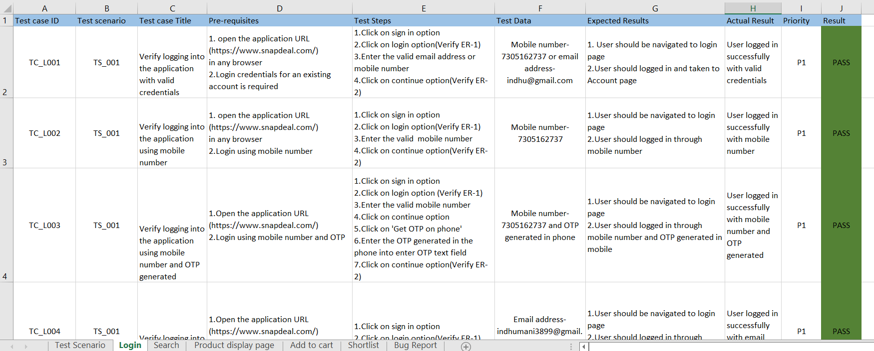
Test case

Slide 19
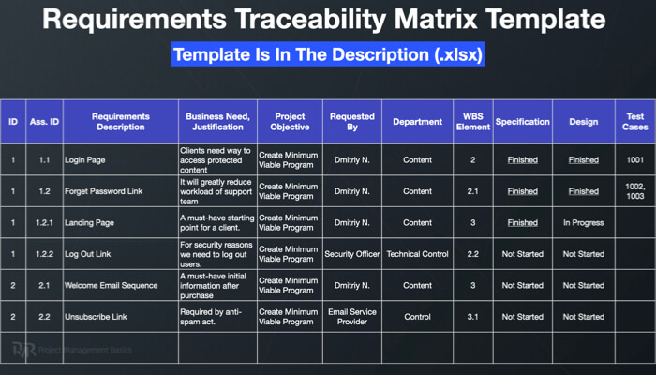
Requirement Traceability Matrix

Slide 20
Bug / Defect report
What is Bug?
A bug is the consequence/outcome of a coding fault.
A Defect in Software Testing is a variation or deviation of the software application from end user’s requirements or original business requirements. A software defect is an error in coding which causes incorrect or unexpected results from a software program which does not meet actual requirements. Testers might come across such defects while executing the test cases.

Slide 21
Defect Report Contents
Defect_ID – Unique identification number for the defect.
Defect Description – Detailed description of the Defect including information about the module in which Defect was found.
Version – Version of the application in which defect was found.
Steps – Detailed steps along with screenshots with which the developer can reproduce the defects.
Date Raised – Date when the defect is raised
Reference– where in you Provide reference to the documents like . requirements, design, architecture or maybe even screenshots of the error to help understand the defect
Detected By – Name/ID of the tester who raised the defect
Status – Status of the defect , more on this later
Fixed by – Name/ID of the developer who fixed it
Date Closed – Date when the defect is closed
Severity which describes the impact of the defect on the application
Priority which is related to defect fixing urgency. Severity Priority could be High/Medium/Low based on the impact urgency at which the defect should be fixed respectively

Slide 22
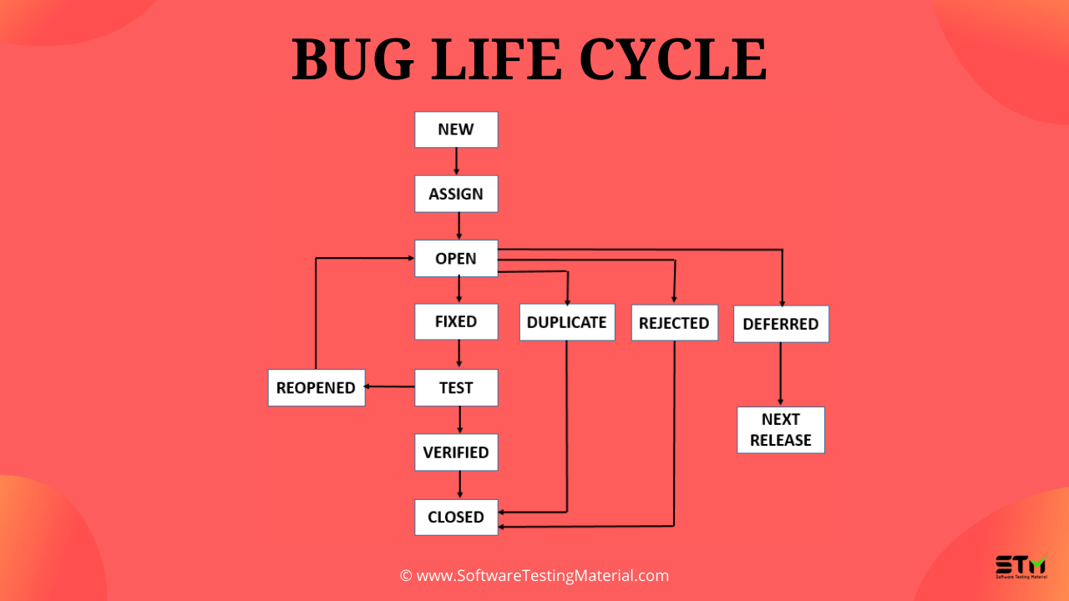
Bug life cycle

Slide 23
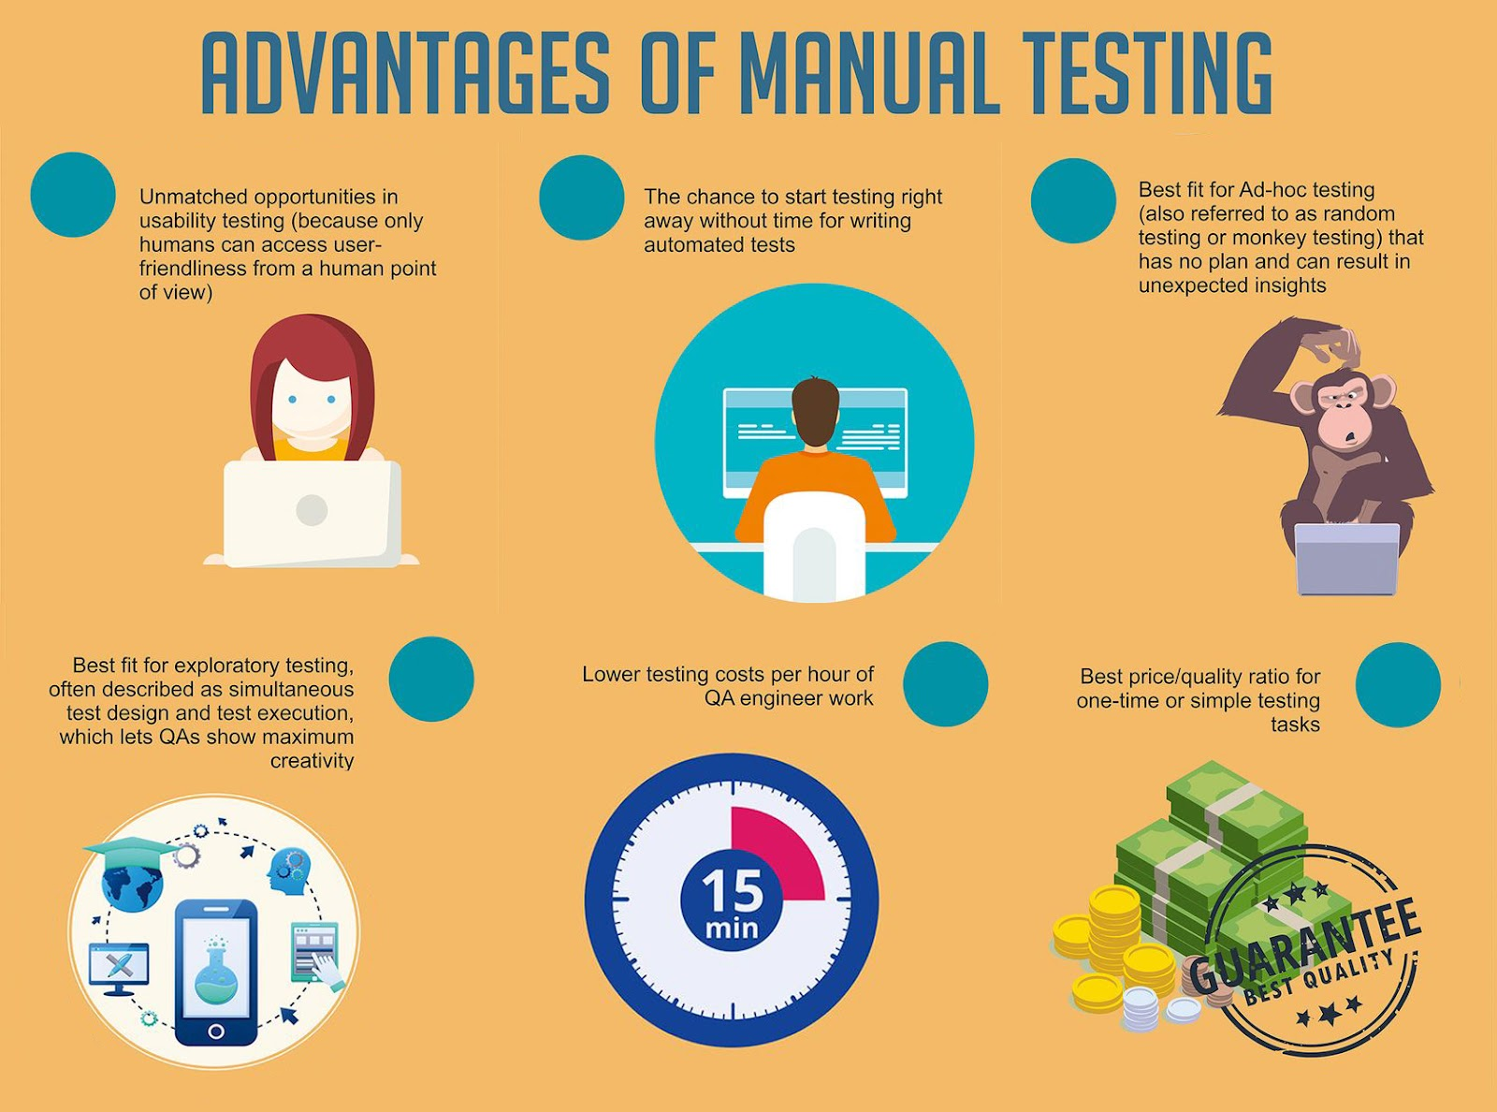

Slide 24
SELENIUM AUTOMATION TESTING ON SNAPDEAL

Slide 25
Automation Testing
Automation testing is the process of testing software and other tech products to ensure it meets strict requirements. Essentially, it’s a test to double-check that the equipment or software does exactly what it was designed to do. It tests for bugs, defects, and any other issues that can arise with product development.
Although some types of testing, such as regression or functional testing can be done manually, there are greater benefits of doing it automatically. Automation testing can be run at any time of the day. It uses scripted sequences to examine the software.

Slide 26
Selenium
Selenium is an open-source and a portable automated software testing tool for testing web applications. It has capabilities to operate across different browsers and operating systems. Selenium is not just a single tool but a set of tools that helps testers to automate web-based applications more efficiently.
It provides a single interface that lets you write test scripts in programming languages like Ruby, Java, NodeJS, PHP, Perl, Python, and C#, among others.

Slide 27
Selenium Tools
Selenium IDE
Selenium RC
Selenium WebDriver
Selenium Grid

Slide 28
Tools Description
Selenium IDE - Selenium Integrated Development Environment (IDE) is a Firefox plugin that lets testers to record their actions as they follow the workflow that they need to test.
Selenium RC - Selenium Remote Control (RC) was the flagship testing framework that allowed more than simple browser actions and linear execution. It makes use of the full power of programming languages such as Java, C#, PHP, Python, Ruby, and PERL to create more complex tests.
Selenium WebDriver Selenium WebDriver is the successor to Selenium RC which sends commands directly to the browser and retrieves results.
Selenium Grid Selenium Grid is a tool used to run parallel tests across different machines and different browsers simultaneously which results in minimized execution time.

Slide 29
Selenium IDE
Selenium IDE (Integrated Development Environment) is an open source web automation testing tool under the Selenium Suite. Unlike Selenium WebDriver and RC, it does not require any programming logic to write its test scripts rather you can simply record your interactions with the browser to create test cases. Subsequently, you can use the playback option to re-run the test cases.
Selenium IDE is available only as Mozilla Firefox and Chrome plug-in, which means you can't record your test cases on browsers other than Firefox and Chrome. The recorded test scripts can also be exported to programming languages like C#, Java, Ruby or Python.

Slide 30
Steps to perform selenium
The broad steps to perform a test through Selenium are as follows –
Download browser drivers
Initiate a Selenium WebDriver
Load web applications
Perform designated actions in a defined test
Assess if the test achieved the desired outcome
Close the WebDriver

Slide 31
What are Locators?
Locator is a command that tells Selenium IDE which GUI elements ( say Text Box, Buttons, Check Boxes etc) its needs to operate on. Identification of correct GUI elements is a prerequisite to creating an automation script. But accurate identification of GUI elements is more difficult than it sounds. Sometimes, you end up working with incorrect GUI elements or no elements at all! Hence, Selenium provides a number of Locators to precisely locate a GUI element
The different locators in Selenium are as follows:
By CSS ID: find_element_by_id
By CSS class name: find_element_by_class_name
By name attribute: find_element_by_name
By DOM structure or xpath: find_element_by_xpath
By link text: find_element_by_link_text
By partial link text: find_element_by_partial_link_text
By HTML tag name: find_element_by_tag_name

Slide 32
Ecommerce Automation
Ecommerce automation is the software that helps your online store convert most or all of the manual, repetitive tasks into self-fulfilling, automated tasks. In other words, this helps you complete tasks automatically rather than doing them manually.
Automating your ecommerce helps get rid of tedious and repetitive tasks, and simplifies processes that could bog you down for whole day long. Below are some examples of ecommerce automation:
Inventory management: Auto-unpublish products when they are out of stock and re-publish when they are back in stock
Customer segmentation: Automatically tag/group customers based on certain attributes such as ordered product, total lifetime spending, geographics, demographics, etc.
High-risk orders: Automatically hold and flag irregularly large orders. Auto-notify customer service team via email for manual review
Internal communication: Auto-notify team members & stakeholders via email whenever a product is out of stock or a VIP customer has just created an account
Scheduled sales campaigns: Auto-publish content on website, including blog posts, banners, website themes. Also, automatically apply discounts, upload new products on sales category

Slide 33
TestNG
TestNG is an automation testing framework in which NG stands for “Next Generation”. TestNG is inspired by JUnit which uses the annotations (@). TestNG overcomes the disadvantages of JUnit and is designed to make end-to-end testing easy.
Using TestNG, you can generate a proper report, and you can easily come to know how many test cases are passed, failed, and skipped. You can execute the failed test cases separately.

Slide 34
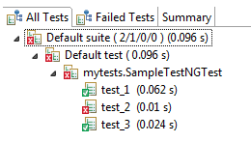
TestNG can generate the report in a readable format like the one shown below.

Slide 35
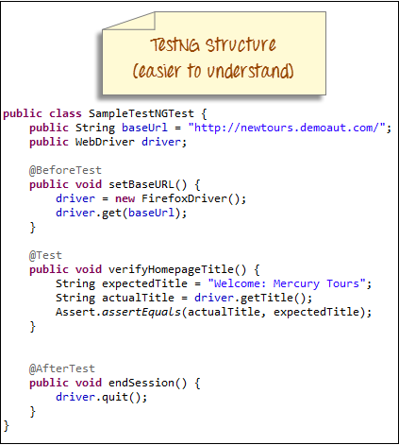
TestNG simplifies the way the tests are coded. There is no more need for a static main method in our tests. The sequence of actions is regulated by easy-to-understand annotations that do not require methods to be static.

Slide 36
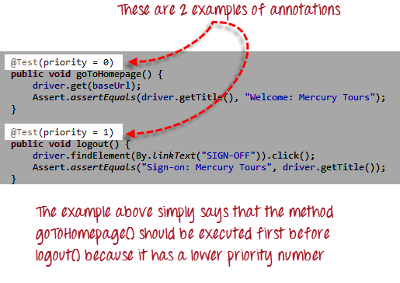
Annotations in TestNG are lines of code that can control how the method below them will be executed. They are always preceded by the @ symbol. A very early and quick TestNG Example is the one shown below.

Slide 37
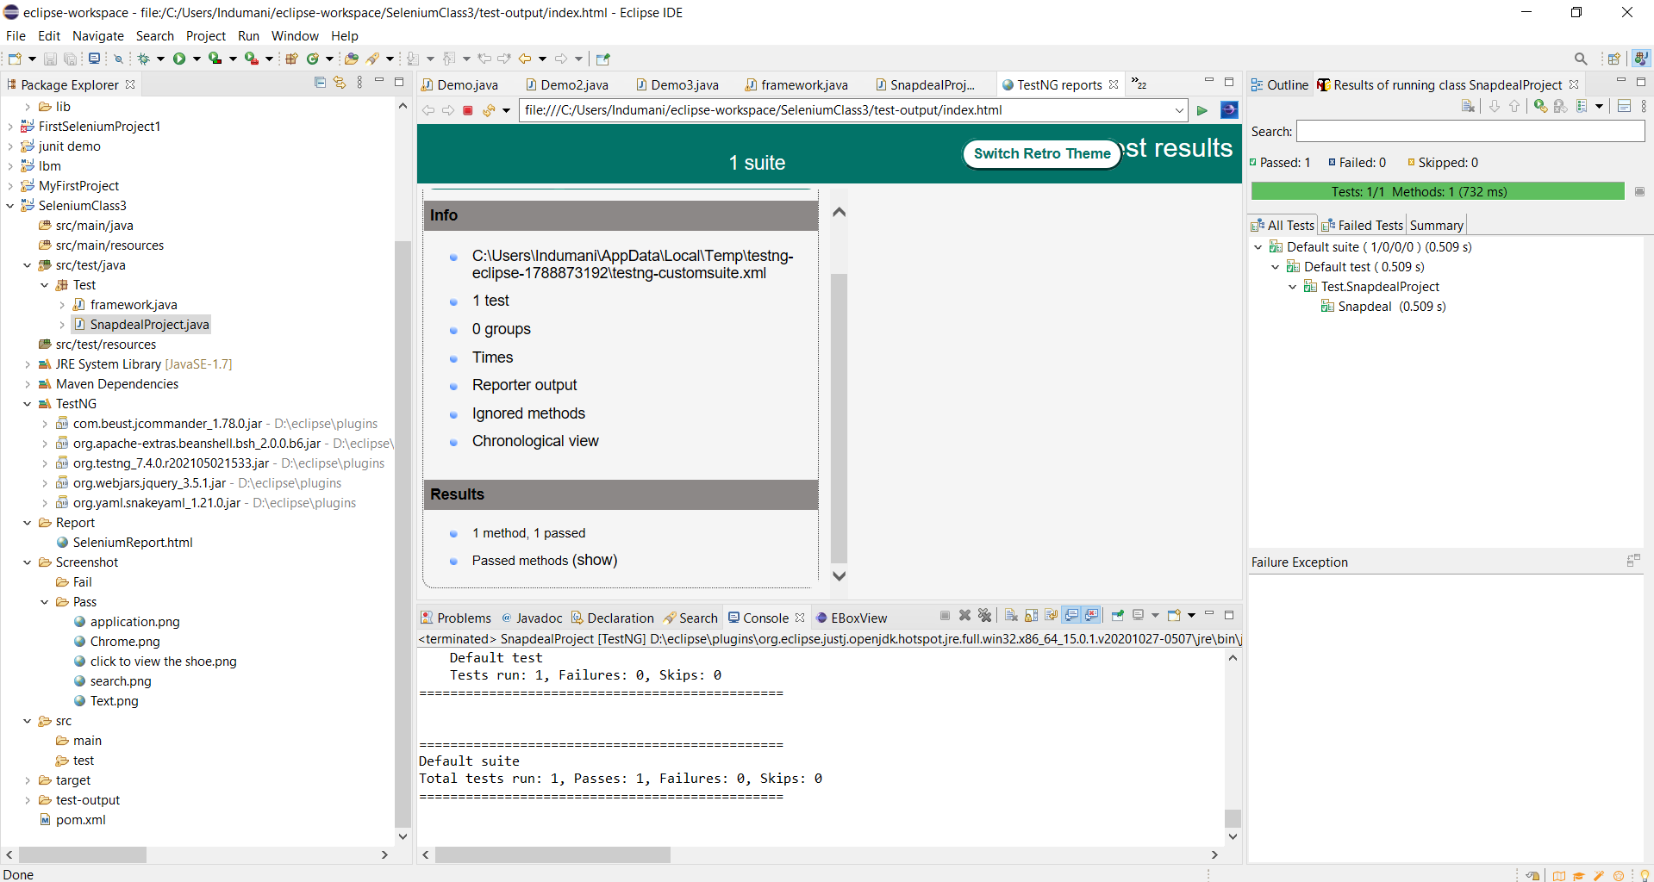
TESTNG REPORT FOR SNAPDEAL

Slide 38
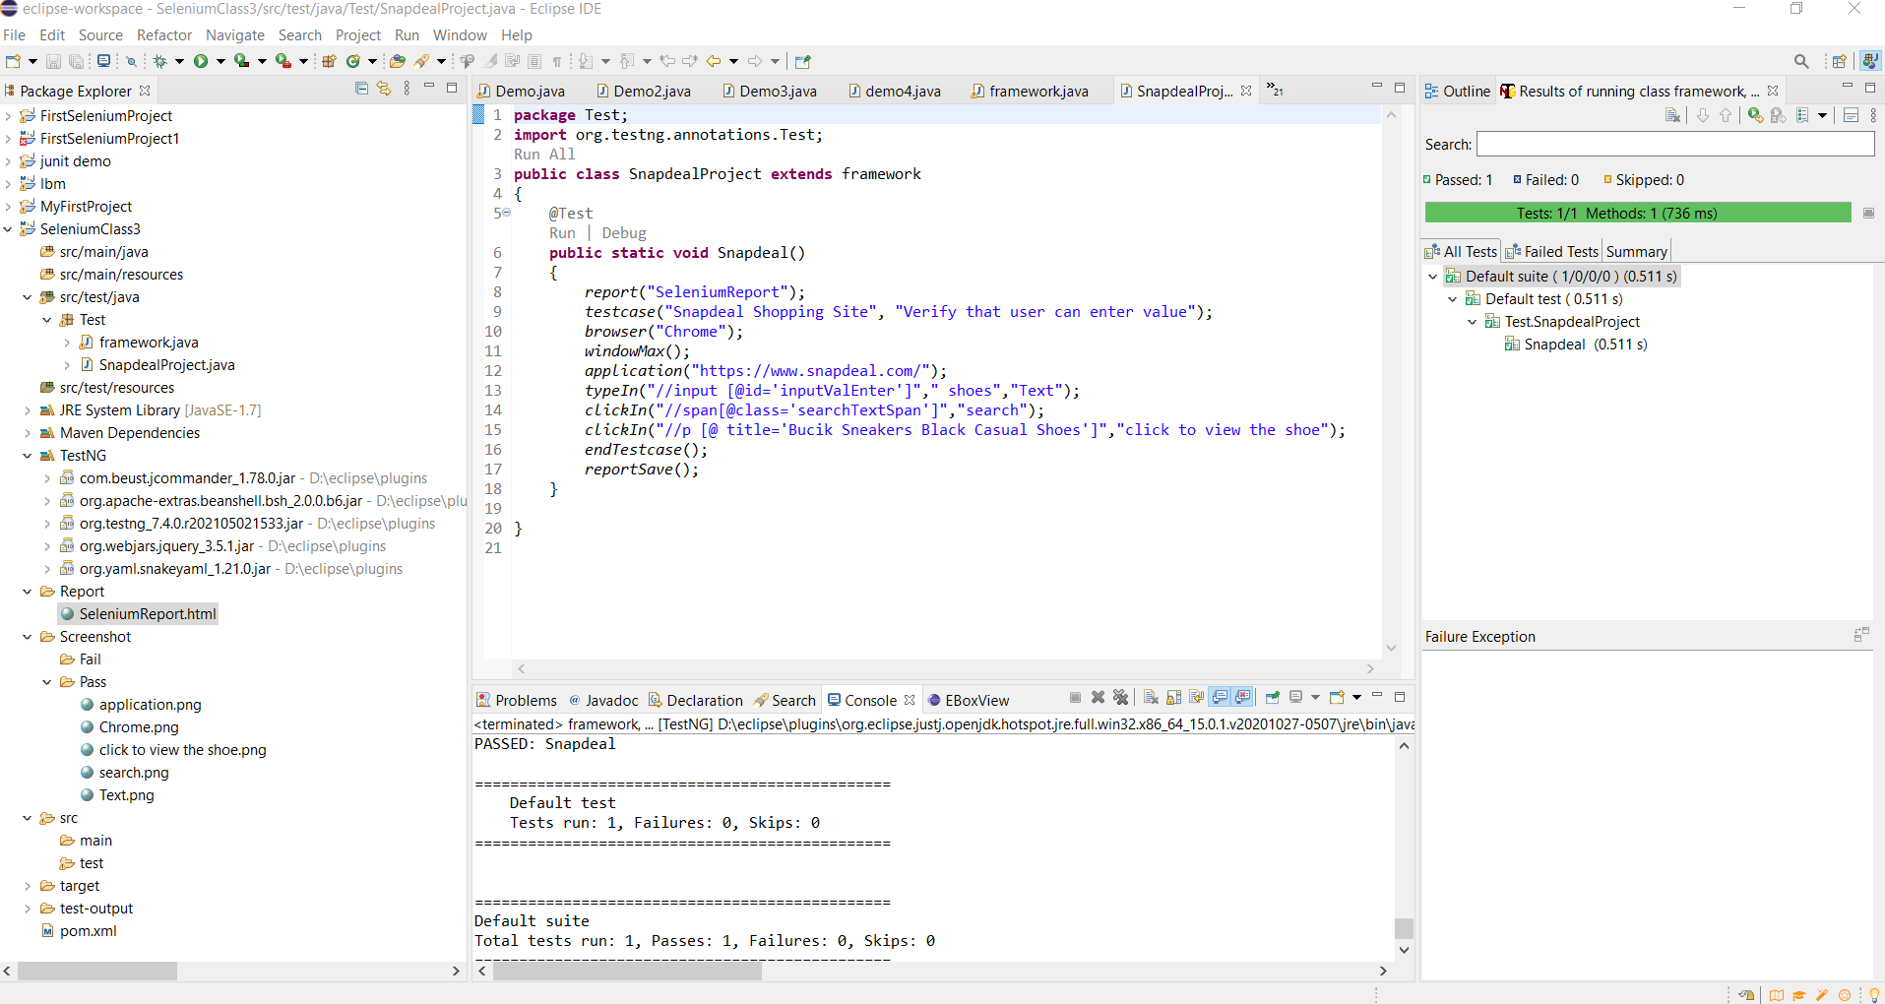

Slide 39
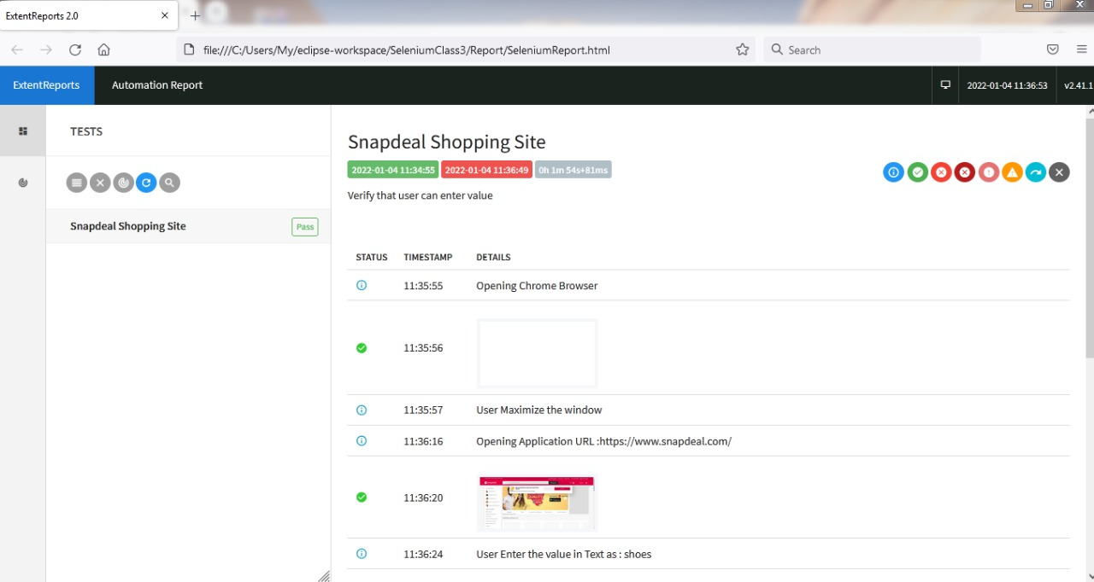
EXTENDED REPORT

Slide 40
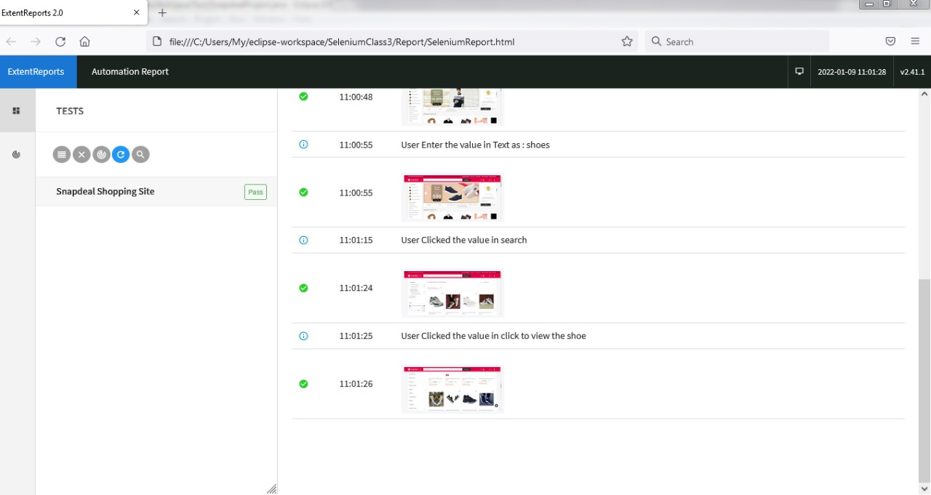

Slide 41
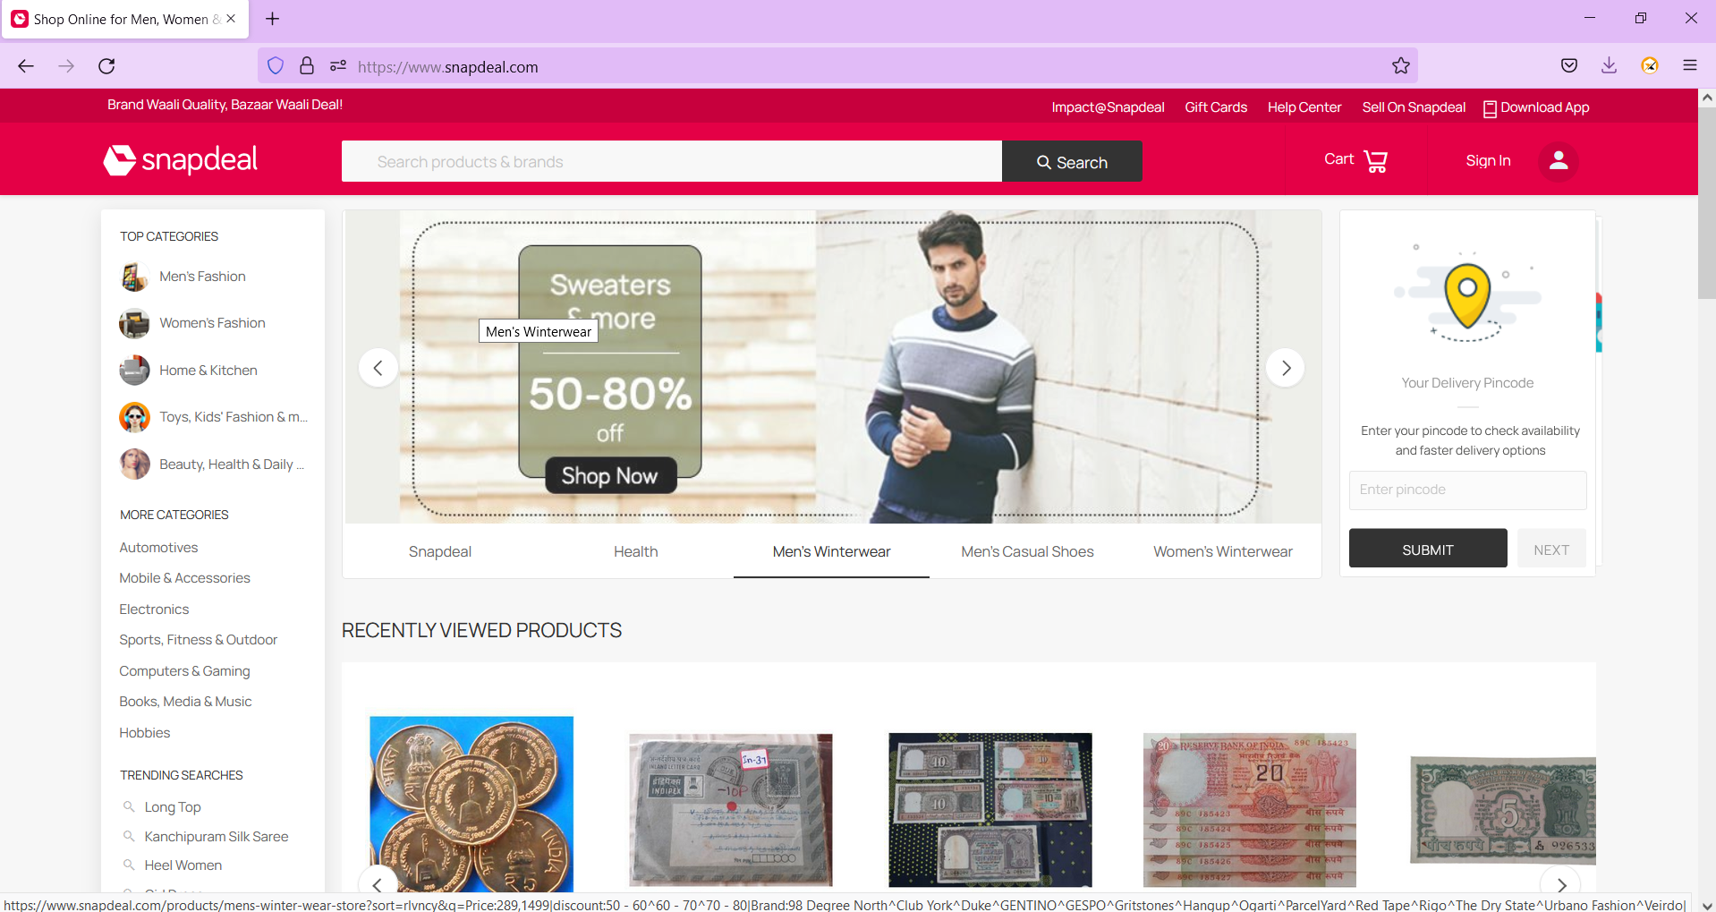
Homepage of Snapdeal

Slide 42
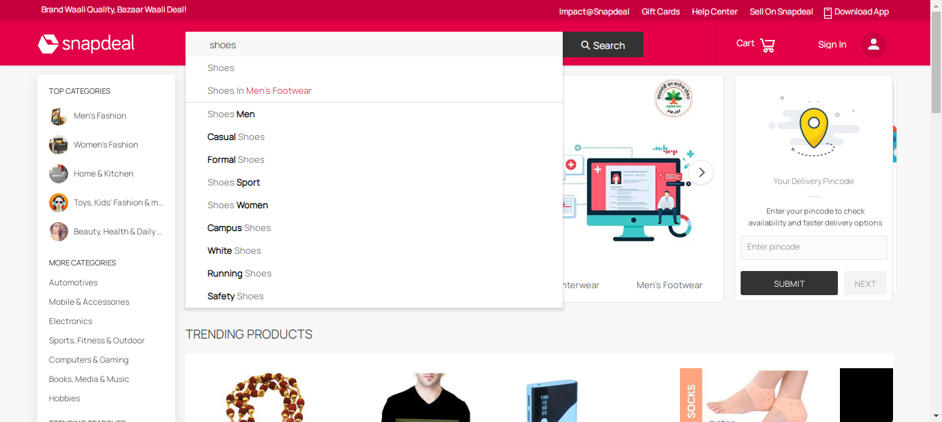
Search Functionality

Slide 43
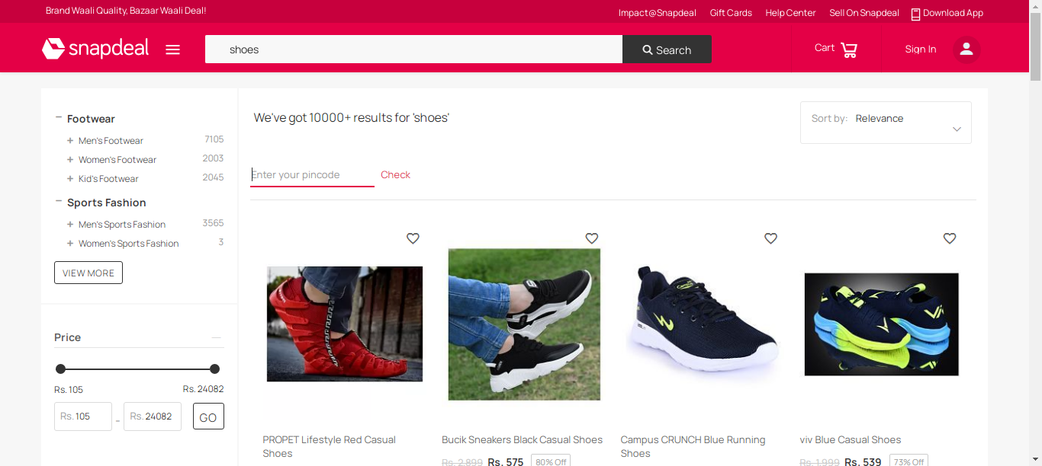

Slide 44
Uniqueness of Automation
It saves your employees' time. Saving time is the main benefit of automation in business.
It helps you reduce costs.
It increases productivity.
It makes business processes more efficient.
It minimizes errors.
It standardizes processes.
It provides auditable records.

Slide 45
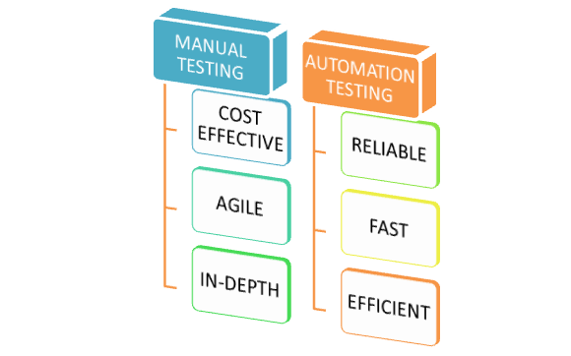

Slide 46
THANK YOU

